Slide 1
CAR RESALE VALUE PREDICTION WITH IBM WATSON MACHINE LEARNING
Team Members:
Thalla Lokesh Reddy
Tummeda Amith Paavan
V Srikruthi
SriPriya
Lavudya Govind Nayak
TEAM: CSE-12

Slide 2
introduction
With difficult economic conditions, it is likely that sales of reconditioned second-hand cars will increase. In most of the countries, it is common to lease a car rather than buying it outright. A lease is a binding contract between a buyer and a seller in which the buyer must pay fixed instalments for a pre-defined number of months/years to the seller/financer. After the lease period is over, the buyer has the possibility to buy the car at its residual value, i.e. its expected resale value. Thus, this application is of commercial interest to seller/financers to be able to predict the residual value of cars with accuracy.

Slide 3



Required softwAres
ANACONDA PROMPT
JUPYTER NOTEBOOK
GOOGLE COLAB
SPYDER
IBM WATSON

Slide 4
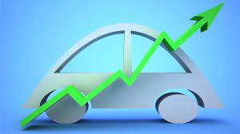

Steps for completing the project
Collection Of Dataset From Kaggle
Building The Model In Jupyter Notebook
Building The Flask App In Spyder Editor
Execution Of The Project In Anaconda Prompt
Checking The Resale Amount Of Cars

Slide 5
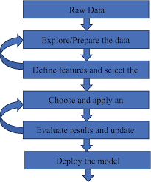
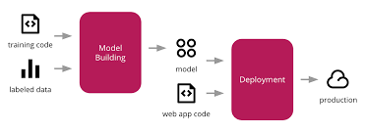
Architecture
-> Web App is created with flask and then
-> Deployment of the model is done with IBM Cloud using IBM Watson

Slide 6


Problem statement
Car Resale Value Prediction With IBM Watson Machine Learning
Let’s get into the solution

Slide 7
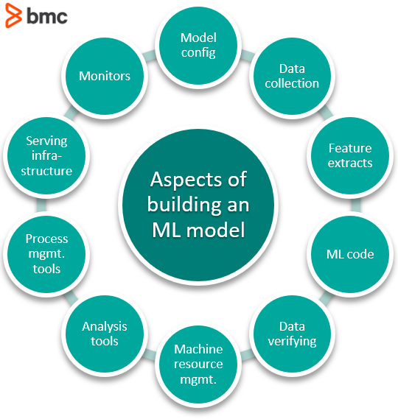
Building the model

Slide 8
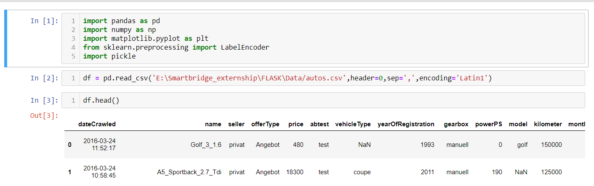
Data preprocessing
Importing the libraries
Reading the dataset

Slide 9
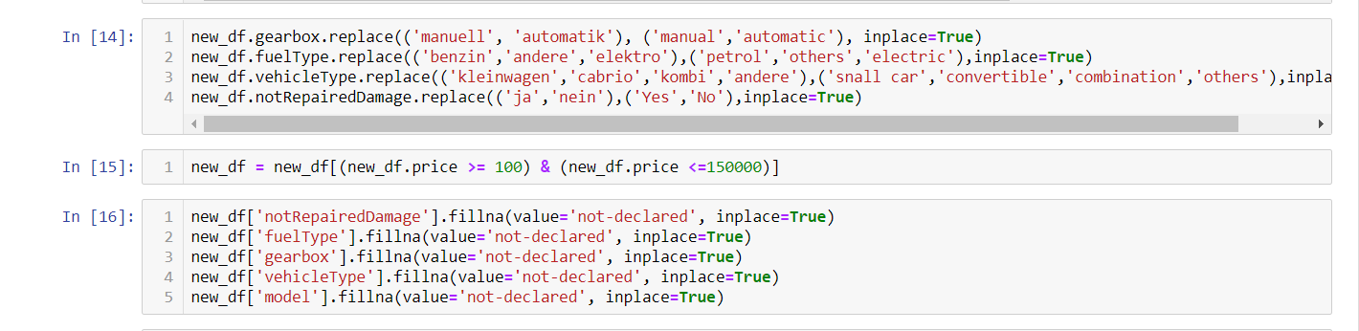
Data preprocessing
Handling null values
Handling categorical data
Spliting data to x and y
Spliting data to train and test
Feature scaling

Slide 10
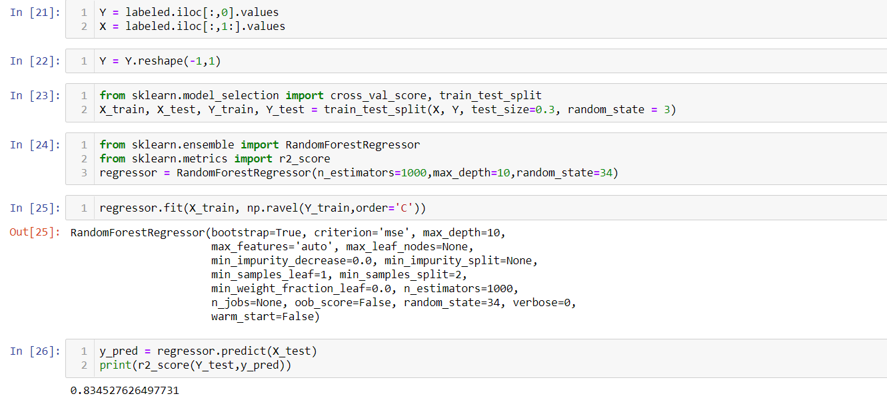
Applying Machine Learning Algorithm
Here we applied Random Forest Regressor for building the model

Slide 11

Building the flask app
Flask App is made in Spyder editor

Slide 12
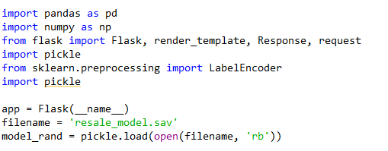
Steps for creation of flask app
Import Necessary Libraries
Load The Dumped File Of Our Model
Create Home Page Of Our App
Write The Function y_predict To Predict The Resale Amount Of A Car
Run The App In Localhost

Slide 13
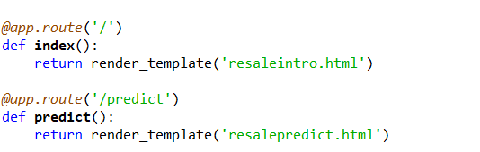
Creation of home page
1. @app.route('/') # app is routed with the URL '/’ –in the localhost:5000
2. >@app.route(‘/predict’) # app is routed with the URL ‘/extractor’ –in the localhost:5000

Slide 14
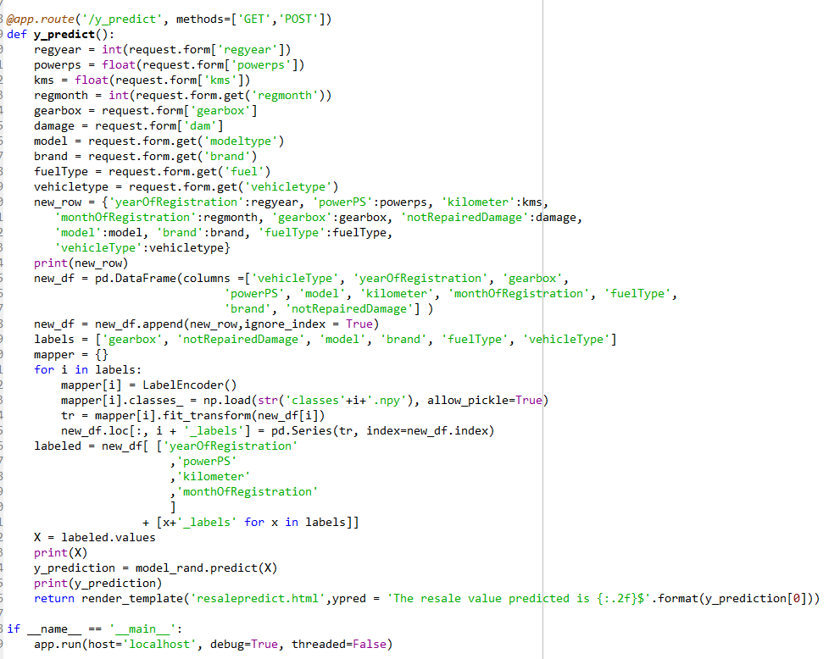
Configure the result page
When form is created with front end language , user fills the data in it.
Those data is taken by backend and predicts the required amount.
This is how this code works in backend of our project.
At last the app is run in localhost:5000 with the code
app.run(debug=‘True’)

Slide 15
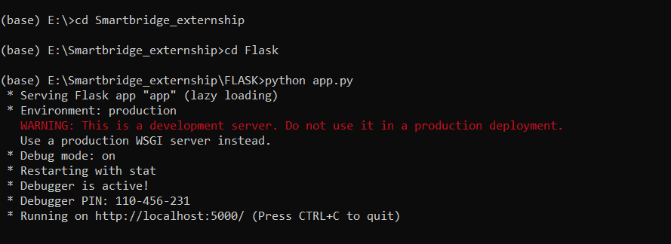
execution of the code
We write the flask code in Spyder and run it on Anaconda Prompt
Open Anaconda Prompt. And change the directory where our project is built. And run as “python app.py” the app is executed in localhost:5000.

Slide 16
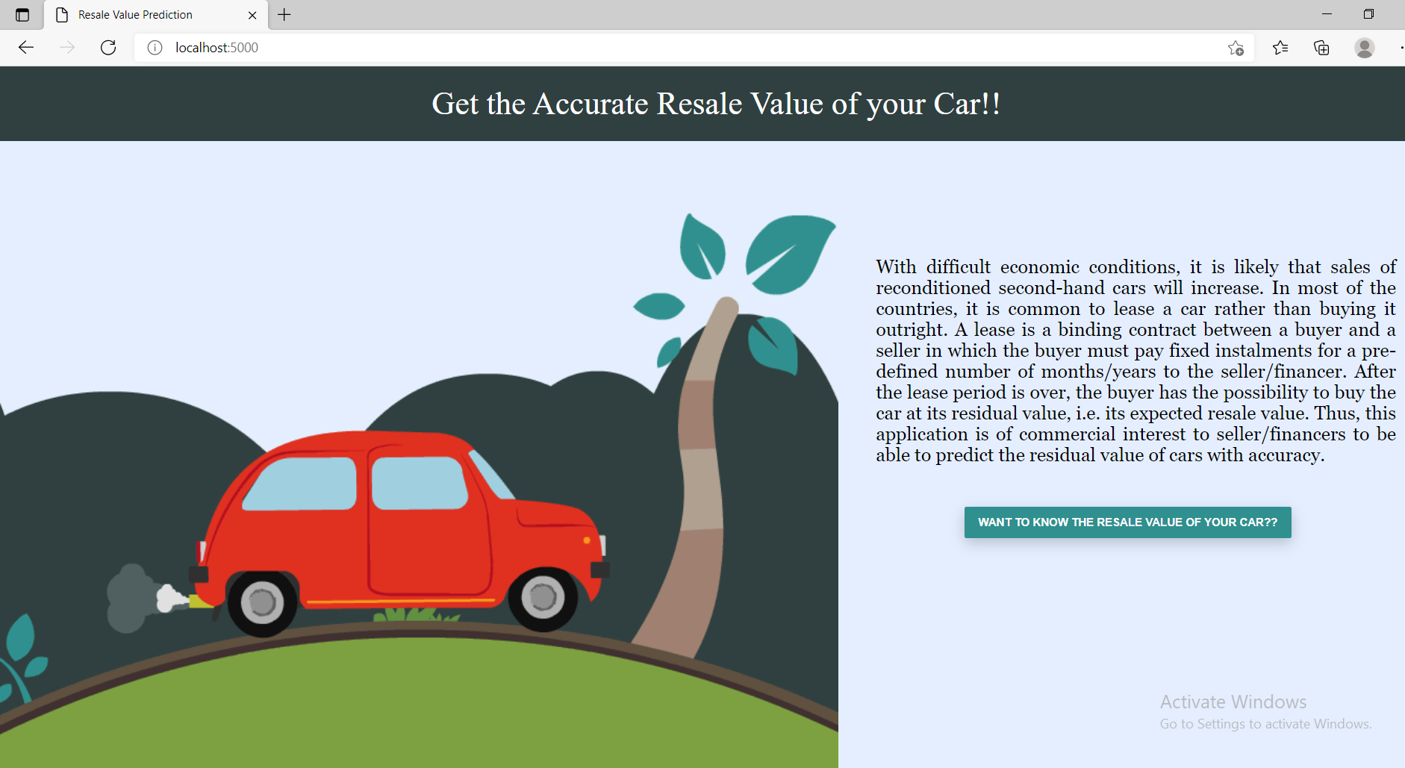
Home page of our project
When user want’s to predict his/her second-hand cars, clicks to the button over there.

Slide 17
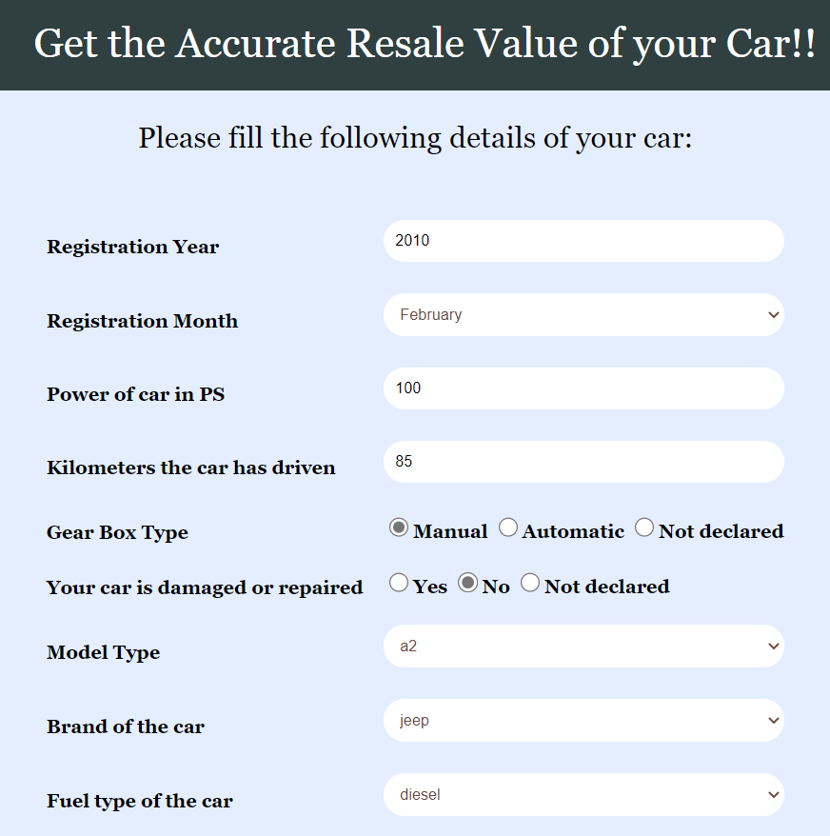
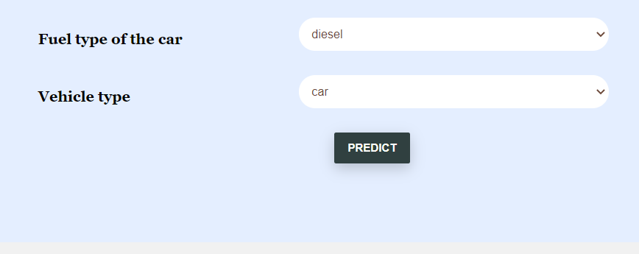
Result
Before Predicting the resale value of a car, user need to fill these required data so that our model can predict the resale values in fraction of seconds.

Slide 18
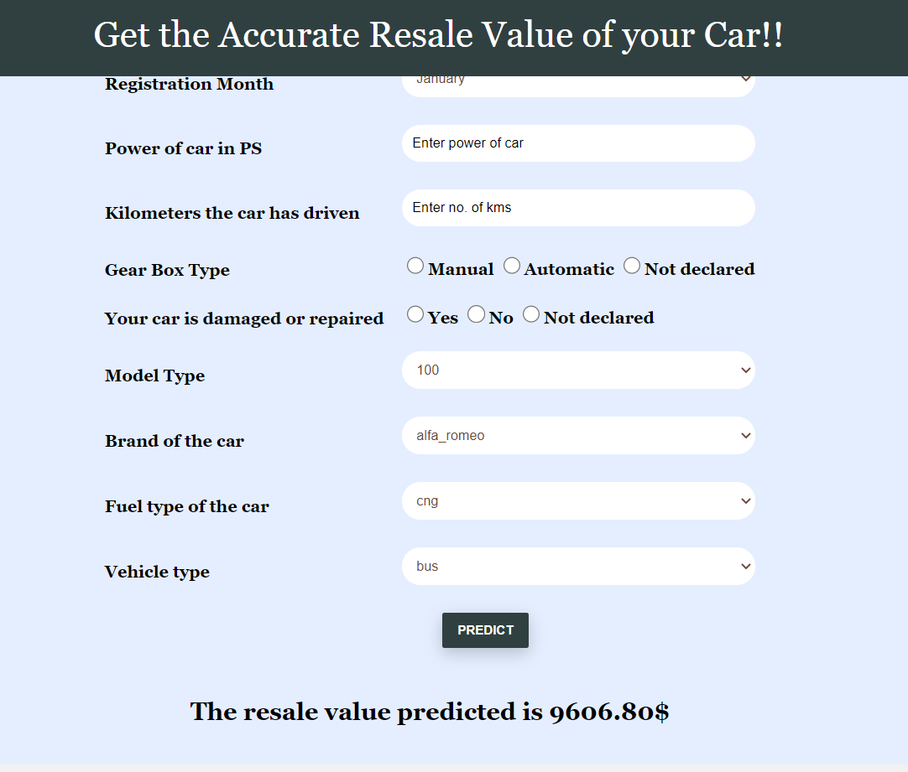
result
This is how our model predicts the resale values of a second-handed car

Slide 19

TEAM: CSE-12

